Slide 1
RNA-Seq Module
BD2K
JAX
2019

Slide 2
Introduction

Slide 3
RNA-Seq statement | True | False
Next-generation sequencing
Quantify RNA in a biological sample at a given moment
To analyze transcriptome
3rd-generation sequencing
Sequencing performs on cDNA not on RNA
Notes:
What do you think what RNA-seq?
What words occur to you when you hear RNA-seq?

Slide 4
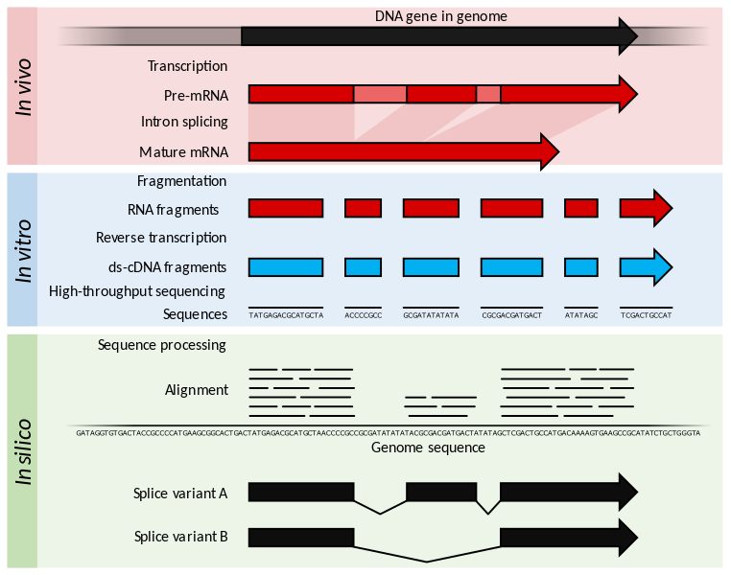
RNA-Seq
Wikimedia Commons

Slide 5
What information you can learn from RNA-Seq?

Slide 6
Applications of RNA-seq
Normal
Cancer
Differential Gene Expression analysis
Steve Munger, 2017

Slide 7
Applications of RNA-seq
Evidence from
RNA-seq
Annotated gene
Novel exon discovery
Steve Munger, 2017

Slide 8
Applications of RNA-seq
exon1
exon2
exon3
Isoform 1
Isoform 2
Alternative splicing
Steve Munger, 2017

Slide 9
Applications of RNA-seq
A
ATGCTCA
AGCTA
A
AGCTA
TAGATGCTCA
AGCTAAT
GCTCA
A
TGCTCA
A
AGCTAA
A
ATGCTCA
AGCTA
A
AGCTA
TAGATGCTCA
AGCTAATC
A
ATGCTCA
A
AGCTA
ATGCTCA
Mom
TAGATGCTCA
A
AGCTAATCCTAG
Dad
TAGATGCTCA
G
AGCTAATCCTAG
G
AGCTATCC
ATGCTCA
ATGCTCA
G
AGCTATCCT
G
AGCTA
ATGCTCA
Allele-Specific gene Expression (ASE)
Preferential expression of one allele over the other.
Steve Munger, 2017

Slide 10
Please order the terms on the circle?
Dündar et al. (2015)

Slide 11

RNA-seq Work Flow
Study Design
RNA isolation/ Library Prep
Sequencing Reads (SE or PE)
Quality
Aligned Reads
Quality
Quantified isoform and gene expression

Slide 12
RNA-Seq
Total RNA
mRNA
mRNA after
fragmentation
cDNA
Adaptors ligated
to cDNA
Single/ Paired End
Sequencing

Slide 13
Know your experiments
How was the library constructed? (total RNA, polyA selection, rRNA depletion or RNA capture) – libraries produced by different methods are not comparable
Single or pair end – mapping differently
Unstranded or forward/reversed – critical for quantification
Number of replicates – At least 2
Read depth and read length – depend on the experimental goal (ENCODE_guideline)

Slide 14
RNA-seq Work Flow
Study Design
RNA isolation/ Library Prep
Sequencing Reads (SE or PE)
Aligned Reads
Quantified isoform and gene expression

Slide 15
Millions and millions of reads…
Fastq format
title
@HISEQ2000_0074:8:1101:7544:2225#TAGCTT/1
TCACCCGTAAGGTAACAAACCGAAAGTATCCAAAGCTAAAAGAAGTGGACGACGTGCTTGGTGGAGCAGCTGCATG
+
CCCFFFFFHHHHDHHJJJJJJJJIJJ?FGIIIJJJJJJIJJJJJJFHIJJJIJHHHFFFFD>AC?B??C?ACCAC>BB<<<>C@CCCACCCDCCIJ
@HISEQ2000_0074:8:1101:7544:2225#TAGCTT/1
The member of a pair
Instrument: run/flowcell id
Flowcell lane and tile number
Index Sequence
X-Y Coordinate in flowcell
Steve Munger, 2017

Slide 16
@HISEQ2000_0074:8:1101:7544:2225#TAGCTT/1
TCACCCGTAAGGTAACAAACCGAAAGTATCCAAAGCTAAAAGAAGTGGACGACGTGCTTGGTGGAGCAGCTGCATG
+
CCCFFFFFHHHHDHHJJJJJJJJIJJ?FGIIIJJJJJJIJJJJJJFHIJJJIJHHHFFFFD>AC?B??C?ACCAC>BB<<<>C@CCCACCCDCCIJ
Sequenc
Quality value
Quality value can be converted to Phred score
Phred Score:
Q = -10 log₁₀ P
10 indicates 1 in 10 chance of error
20 indicates 1 in 100,
30 indicates 1 in 1000,
Note: different sequencing platforms have different ways of recording quality score
Steve Munger, 2017

Slide 17


Quality Control: How to tell if your data is clean
FASTX-Toolkit
http://hannonlab.cshl.edu/fastx_toolkit/
FastQC
http://www.bioinformatics.babraham.ac.uk/projects/fastqc/
NGS Data Preprocessing

Slide 18
Trim or not trim?
Signal/noise -> Preprocessing can remove low-quality “noise”, and adapters but the cost is information loss.
Some uniformly low-quality reads map uniquely to the genome.
Trimming reads to remove lower quality ends can adversely affect alignment, especially if aligning to the genome and the read spans a splice site.
Most aligners can take quality scores into consideration.
Currently, we do not recommend preprocessing reads aside from removing uniformly low quality samples.
Debate: http://www.ecseq.com/support/ngs/trimming-adapter-sequences-is-it-necessary

Slide 19
RNA-seq Work Flow
Study Design
RNA isolation/ Library Prep
Sequencing Reads (SE or PE)
Aligned Reads
Quantified isoform and gene expression
19

Slide 20
Alignment 101
100bp Read
ACATGCTGCGGA
Reference sequence
Chr 3
ACATGCTGCGGA
Chr 2
Chr 1
Steve Munger, 2017

Slide 21
The perfect read: 1 read = 1 unique alignment.
100bp Read
ACATGCTGCGGA
✓
Chr 3
ACATGCTGCGGA
Chr 2
Chr 1
Steve Munger, 2017

Slide 22
Some reads will align equally well to multiple locations. “Multireads”
100bp Read
✗
ACATGCTGCGGA
✓
ACATGCTGCGGA
✗
ACATGCTGCGGA
Ignore them
Weight them
Tools: mmquant, MMR, seqcluster, etc.
1 read
3 valid alignments
Only 1 alignment is correct
ACATGCTGCGGA
Steve Munger, 2017

Slide 23
Aligning Millions of Short Sequence Reads
Gene A
Gene B
Aligners: STAR, HISAT2, TopHat2
Notes:
Different aligner have different strategies to align and detect alternative splicing.

Slide 24
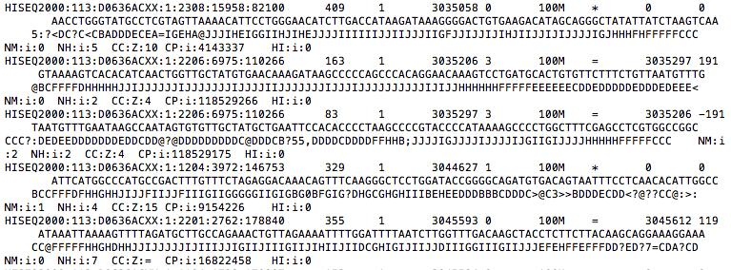
Output of most aligners: Bam/Sam file of reads and genome positions
Tools to handle Bam/Sam files: samtools, bamUtil

Slide 25
Quality control post alignment
RNA-SeQC
https://github.com/broadinstitute/rnaseqc
Output metrics: Mapping Rate, unique rate of mapped, duplicate rate, expression profiling efficiency, coverage, …

Slide 26
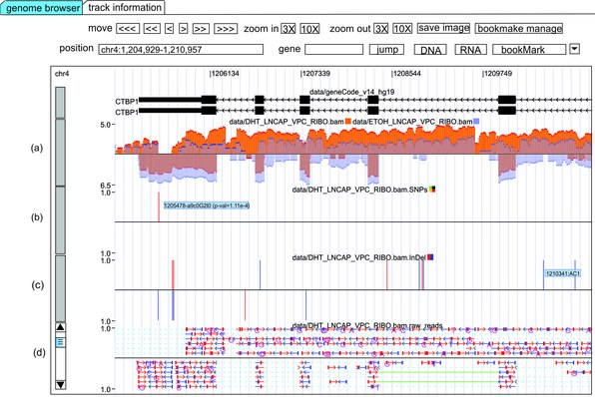
Visualization of alignment data (BAM/SAM)
Genome browsers – IGV and RNASeqBrowser
Integrative Genome Viewer (IGV)
http://software.broadinstitute.org/software/igv/download
RNASeqBrowser
http://www.australianprostatecentre.org/research/software/rnaseqbrowser

Slide 27
RNA-seq Work Flow
Study Design
RNA isolation/ Library Prep
Sequencing Reads (SE or PE)
Aligned Reads
Quantified isoform and gene expression
27

Slide 28
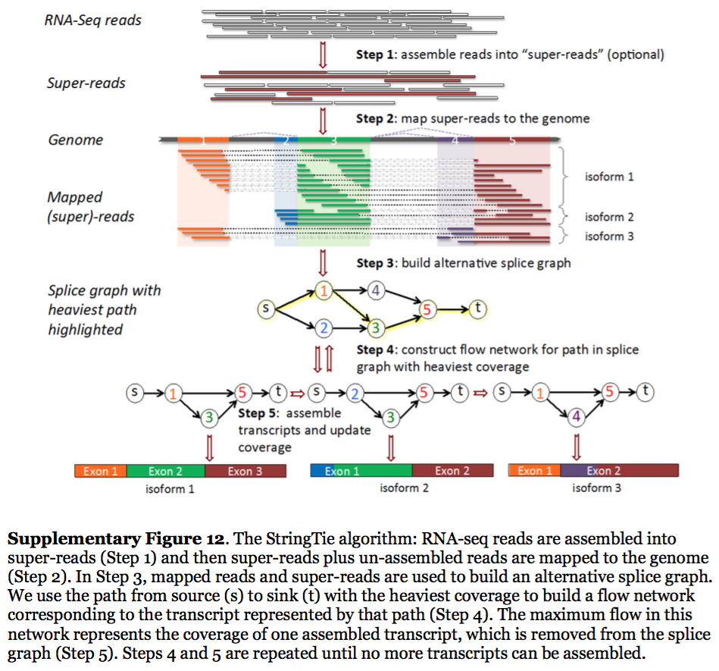
Transcript quantification
StringTie reconstruct transcripts from spliced read alignments generated by previously mentioned aligners
* Sailfish, Kallisto and Salmon align reads to annotated transcriptome sequences
Pertea, 2015

Slide 29
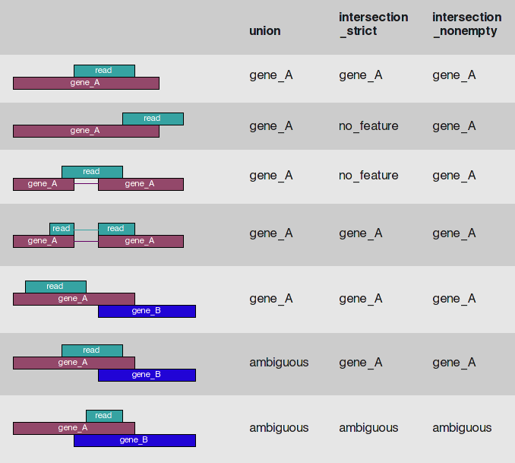
Gene expression
HTseq-count read/feature overlap modes
* Another popular tool: featureCounts (http://bioinf.wehi.edu.au/featureCounts/)
HTseq-count documentation

Slide 30
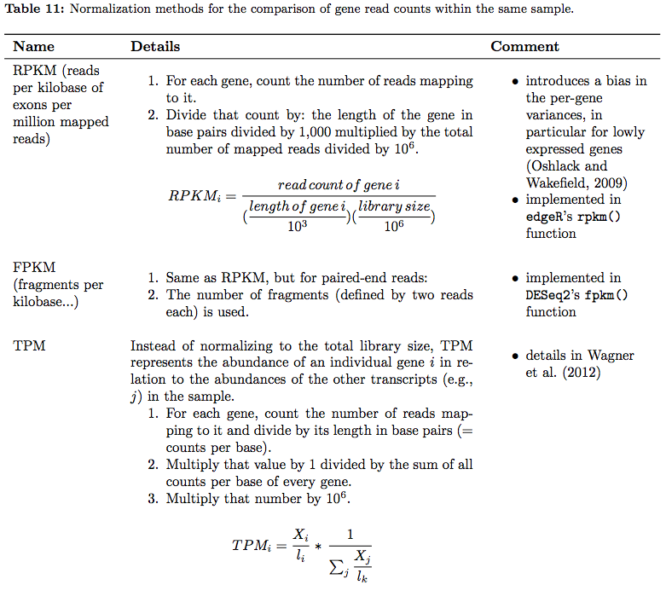
Expression Abundance: Counts, RPKM/FPKM, TPM
* Raw counts are required input for differential analysis by DESeq2 and EdgeR
Good for comparison within one sample but not for cross sample comparison
Dündar et al. 2015

Slide 31
More downstream analysis
Differential expression analysis – DESeq2, EdgeR, and limma-voom (Schurch et al. 2015 for reviews of DE tools)
Gene set enrichment analysis i.e. Gene Ontology (GO) – GOrilla, DAVID, g:profiler
Network-based - GeneMania

Slide 32
Interactive web-based tools
Galaxy (https://usegalaxy.org)
GenomeSpace (http://www.genomespace.org)
Degust: Perform RNA-seq analysis and visualization (http://degust.erc.monash.edu/degust-old/index.html)

Slide 33
Where to get the data?
GenBank (http://www.ncbi.nlm.nih.gov/genbank/)
ENA (https://www.ebi.ac.uk/ena/)
DDBJ (http://www.ddbj.nig.ac.jp/intro-e.html)
ENCODE (https://www.encodeproject.org)

Slide 34
RNA-Seq is still evolving
Single cell
Longer reads
Nascent RNA-Seq
“RNA-Seq is not a mature technology. It is undergoing rapid evolution of biochemistry of sample preparation; of sequencing platforms; of computational pipelines; and of subsequent analysis methods that include statistical treatments and transcript model building.” From ENCODE RNA-Seq analysis guidelines
Keep updated

Slide 35
Resources
https://www.ebi.ac.uk/gxa/home
https://www.ncbi.nlm.nih.gov/gds
https://portal.gdc.cancer.gov
https://www.ebi.ac.uk/arrayexpress/
Pipeline tool: Bcbio-nextgen https://bcbio-nextgen.readthedocs.io/en/latest/

Slide 36
http://cosi.iscb.org/wiki/Education:Home

Slide 37
RNA-Seq hands-on

Slide 38
Outline
Prepare data
Alignment
Count feature
DE analysis
Gene set enrichment analysis

Slide 39
Background

Slide 40
Background
Pax6

Slide 41
Data fact
Data
Poly-A selected
Reverse stranded

Slide 42
Open up galaxy …

